Slide 1
Welcome to JWAC!
September 27, 2017

Slide 2
Meeting dates
*************NOT Oct 4th due to Ms. Perry scheduling conflict *************NOT Oct 11 due to PSAT Oct 18 Oct 25 Nov 01 Nov 08 Nov 15 ************NOT Nov 22 due to Thanksgiving Nov 29 Dec 06 Dec 13 ************NOT Dec 20 due to Exams

Slide 3
PLEASE SIGN UP FOR THE REMIND
Text @allenjwac to 81010

Slide 4
Dues!
$20
Due: 10/18
Must be paid at a JWAC Meeting
Cash or Check (If Check, make Checks payable to “AHS JWAC” and include Driver’s License number and phone number)

Slide 5
Model UN Vote

Slide 6
Model UN
If YMCA MUN…
$30 Registration fee
$35 Regional Summit Conference fee
$10 Invitational Conference fee
$13 Other expenses (MUN registration/transportation/state conference)

Slide 7
Co-Sponsor
Model UN

Slide 8
WorldQuest

Slide 9
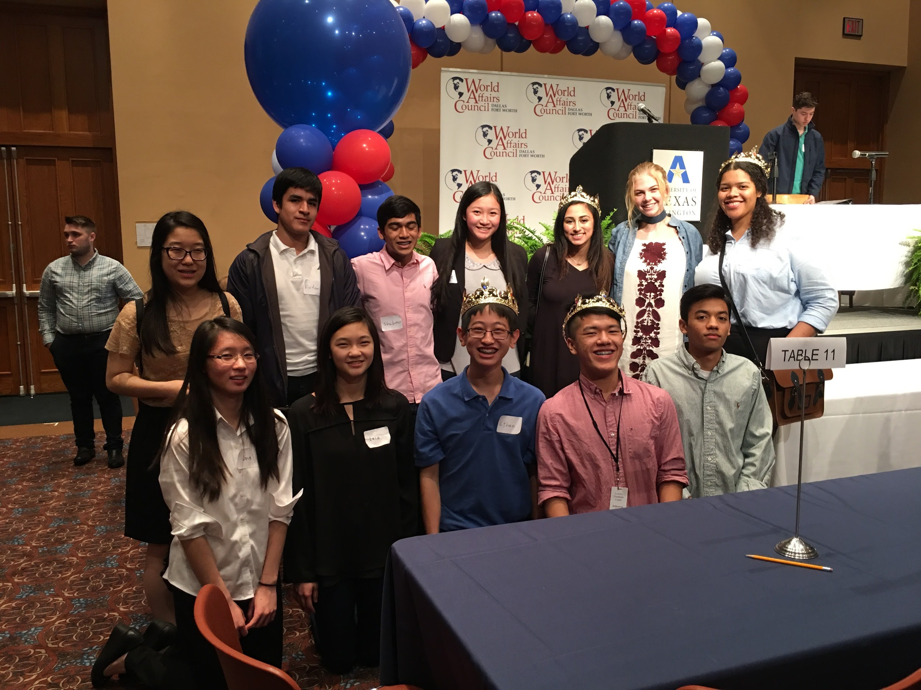
Allen High School JWAC teams, WorldQuest 2017

Slide 10
WorldQuest
Local competition
February 15, 2018
10 topics
Countries, politics, global issues
(12 members)

Slide 11
WorldQuest
2017-18
NAFTA
ASEAN at 50
India’s Bid for Global Leadership
Combatting Climate Change
Cybersecurity
Saudi Arabia
Great Decisions
The Peacebuilding Toolkit
America’s Diplomats
Current Events

Slide 12
WorldQuest Simulation (#1)
Split into groups of 4
Open WorldQuest Study Guide link via Remind

Slide 13
WorldQuest Simulation #1
You have 20 minutes!
Scan these topics: (WorldQuest Study guide link will be sent via Remind)
NAFTA
India’s Bid
Cybersecurity
Peacebuilding Toolkit
8 Question Quiz (2 questions per topic) - Work together!

Slide 14
WorldQuest Simulation Quiz 1

Slide 15
WorldQuest Simulation Quiz 1 - NAFTA
One reason NAFTA remains controversial is that, for the United States, NAFTA marked the first major trade deal with a poor country, namely ___
Mexico
Venezuela
Cuba
El Salvador

Slide 16
WorldQuest Simulation Quiz 1 - NAFTA
2. Which of the following charges by NAFTA critics was deemed a fair criticism according to the Peterson Institute of Economics?
NAFTA fostered a growing US trade deficit.
Trade with Mexico raised US unemployment.
Job loss depressed US wages, especially in manufacturing
Mexican growth has not achieved the rate anticipated by NAFTA proponents.

Slide 17
WorldQuest Simulation Quiz 1 - India’s Bid
3. According to the Carnegie Endowment for International Peace, which of the following is not what India must do to become a leading power?
Complete the structural reforms necessary to create efficient product and factor markets.
Create an effective state to leverage India’s capacity to build its national power.
Foster a strong relationship with the United States.
Maintain current extractive and regulatory capacities

Slide 18
WorldQuest Simulation Quiz 1 - India’s Bid
4. According to research released last week at a United Nations climate meeting in Germany, China and India should easily exceed the targets they set for themselves in the 2015 Paris Agreement signed by more than 190 countries. China’s emissions of carbon dioxide appear to have peaked more than 10 years sooner than its government had said they would. And India is now expected to obtain ___ percent of its electricity from non-fossil fuel sources by 2022, eight years ahead of schedule.
30%
40%
50%
60%

Slide 19
WorldQuest Simulation Quiz 1 - Cybersecurity
5. Russia's alleged meddling in the 2016 U.S. presidential elections has brought the issue of ____ again to the top of the news, but the possibilities it raises are only the tip of the iceberg when it comes to the role of ___ in modern warfare.
Cyberwar....cyber operations
Cyber attacks….technology
Fake news….reporters
Hackers….cyber attacks

Slide 20
WorldQuest Simulation Quiz 1 - Cybersecurity
6. Which of the following is the Defense Department’s second primary cyber missions?
DoD must defend its own networks, systems, and information.
DoD must be prepared to defend the United States and its interests against cyberattacks of significant consequence.
If directed by the President or the Secretary of Defense, DoD must be able to provide integrated cyber capabilities to support military operations and contingency plans.
Dod must maintain control over databases containing sensitive information

Slide 21
WorldQuest Simulation Quiz 1 - Peacebuilding Toolkit
7. Which of the following of the Spectrum of Peacebuilding Tools epitomize the concept of local ownership?
Communication, Dialogue, Negotiation
Communication, Negotiation, Mediation
Meditation, Communication, Negotiation
Dialogue, Negotiation, Mediation

Slide 22
WorldQuest Simulation Quiz 1 - Peacebuilding Toolkit
8. _____ —as defined for this [USIP] report—is a facilitated, conflict-intervention process that brings together various stakeholders in a conflict or around a problem or concern, to express, listen to, explore, and better understand diverse views in order to transform individual, relational, or structural drivers of conflict.
Dialogue
Negotiation
Communication
Mediation

Slide 23
WorldQuest Simulation Quiz 1 Answers

Slide 24
WorldQuest Simulation Quiz 1 - NAFTA
One reason NAFTA remains controversial is that, for the United States, NAFTA marked the first major trade deal with a poor country, namely ___
Mexico
Venezuela
Cuba
El Salvador

Slide 25
WorldQuest Simulation Quiz 1 - NAFTA
2. Which of the following charges by NAFTA critics was deemed a fair criticism according to the Peterson Institute of Economics?
NAFTA fostered a growing US trade deficit.
Trade with Mexico raised US unemployment.
Job loss depressed US wages, especially in manufacturing
Mexican growth has not achieved the rate anticipated by NAFTA proponents.

Slide 26
WorldQuest Simulation Quiz 1 - India’s Bid
3. According to the Carnegie Endowment for International Peace, which of the following is not what India must do to become a leading power?
Complete the structural reforms necessary to create efficient product and factor markets.
Create an effective state to leverage India’s capacity to build its national power.
Foster a strong relationship with the United States.
Maintain current extractive and regulatory capacities

Slide 27
WorldQuest Simulation Quiz 1 - India’s Bid
4. According to research released last week at a United Nations climate meeting in Germany, China and India should easily exceed the targets they set for themselves in the 2015 Paris Agreement signed by more than 190 countries. China’s emissions of carbon dioxide appear to have peaked more than 10 years sooner than its government had said they would. And India is now expected to obtain ___ percent of its electricity from non-fossil fuel sources by 2022, eight years ahead of schedule.
30%
40%
50%
60%

Slide 28
WorldQuest Simulation Quiz 1 - Cybersecurity
5. Russia's alleged meddling in the 2016 U.S. presidential elections has brought the issue of ____ again to the top of the news, but the possibilities it raises are only the tip of the iceberg when it comes to the role of ___ in modern warfare.
Cyberwar....cyber operations
Cyber attacks….technology
Fake news….reporters
Hackers….cyber attacks

Slide 29
WorldQuest Simulation Quiz 1 - Cybersecurity
6. Which of the following is the Defense Department’s second primary cyber mission?
DoD must defend its own networks, systems, and information.
DoD must be prepared to defend the United States and its interests against cyberattacks of significant consequence.
If directed by the President or the Secretary of Defense, DoD must be able to provide integrated cyber capabilities to support military operations and contingency plans.
Dod must maintain control over databases containing sensitive information

Slide 30
WorldQuest Simulation Quiz 1 - Peacebuilding Toolkit
7. Which of the following of the Spectrum of Peacebuilding Tools epitomize the concept of local ownership?
Communication, Dialogue, Negotiation
Communication, Negotiation, Mediation
Force, Communication, Negotiation
Dialogue, Negotiation, Mediation

Slide 31
WorldQuest Simulation Quiz 1 - Peacebuilding Toolkit
8. _____ —as defined for this [USIP] report—is a facilitated, conflict-intervention process that brings together various stakeholders in a conflict or around a problem or concern, to express, listen to, explore, and better understand diverse views in order to transform individual, relational, or structural drivers of conflict.
Dialogue
Negotiation
Communication
Mediation

