Slide 1
Welcome to JWAC!
September 20, 2017

Slide 2
Meeting dates
Sept 20 Sept 27 *************NOT Oct 4th due to Ms. Perry scheduling conflict *************NOT Oct 11 due to PSAT Oct 18 Oct 25 Nov 01 Nov 08 Nov 15 ************NOT Nov 22 due to Thanksgiving Nov 29 Dec 06 Dec 13 ************NOT Dec 20 due to Exams

Slide 3
PLEASE SIGN UP FOR THE REMIND
Text @allenjwac to 81010

Slide 4
Dues!
$20
Due: 10/18
Must be paid at a JWAC Meeting (today or next Wednesday)
Cash or Check (If Check, make Checks payable to “AHS JWAC” and include Driver’s License number and phone number)

Slide 5
T-shirts!
Order on your own at Customink: https://www.customink.com/g/fmz0-00b5-p73d
(Link will also be sent via Remind)
$11.84
Optional but strongly recommended members buy one!
Due: 10/2 (Order form closes)

Slide 6
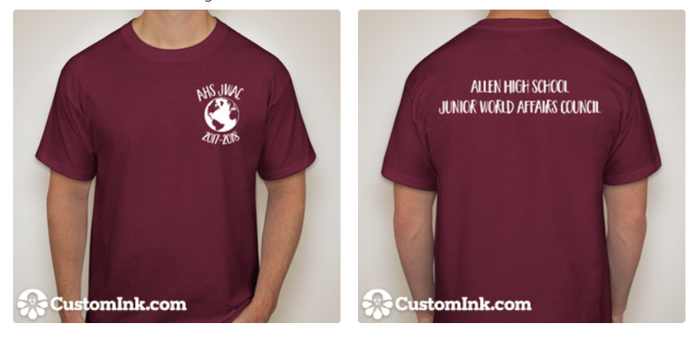
T-shirts!
Order on your own at Customink: https://www.customink.com/g/fmz0-00b5-p73d
(Link will also be sent via Remind)
$11.84
Optional but strongly recommended members buy one!
Due: 10/2 (Order form closes)

Slide 7
Weekly News Quiz

Slide 8
Providing new evidence of Russian interference in the 2016 election, ________ disclosed on Sept. 6 that it had identified more than $100,000 worth of divisive ads on hot-button issues purchased by a shadowy Russian company linked to the Kremlin.
Snapchat
Google
Yahoo!
Facebook
I’m Russian to JWAC because I love it so much!

Slide 9
2. The number of _______ who have fled fighting in western Myanmar has climbed sharply to 270,000, placing a huge strain on camps in Bangladesh where they are seeking shelter, the United Nations refugee agency said on Sept. 8.
Christians
Bengali minorities
Rohingya
Indians
Bengali Flag

Slide 10
3. The most powerful earthquake to hit ________ in 100 years struck off the nation’s Pacific Coast overnight, killing dozens and leveling some areas near the epicenter, in the south.
Chile
California
Mexico
Peru
Argentinian Flag

Slide 11
4. President Trump struck a deal with Democratic congressional leaders on Sept. 6 to _________ and finance the government until mid-December, blindsiding his own Republican allies as he reached across the aisle to resolve a major dispute for the first time since taking office.
Increase debt limit
Increase affordable housing
Limit immigration into the U.S.
Increase aid for Houston after hurricane Harvey
American Flag

Slide 12
5. Hurricane ______ has recently been upgraded to a category 1 hurricane this Sunday, as it follows hurricane Irma’s path.
Isaac
Maria
Lee
Disney
Jamaican me crazy about JWAC!

Slide 13
Answers
D
C
C
A
B

Slide 14
Providing new evidence of Russian interference in the 2016 election, ________ disclosed on Sept. 6 that it had identified more than $100,000 worth of divisive ads on hot-button issues purchased by a shadowy Russian company linked to the Kremlin.
Snapchat
Google
Yahoo!
Facebook
I’m Russian to JWAC because I love it so much!

Slide 15
2. The number of _______ who have fled fighting in western Myanmar has climbed sharply to 270,000, placing a huge strain on camps in Bangladesh where they are seeking shelter, the United Nations refugee agency said on Sept. 8.
Christians
Bengali minorities
Rohingya
Indians
Bengali Flag

Slide 16
3. The most powerful earthquake to hit ________ in 100 years struck off the nation’s Pacific Coast overnight, killing dozens and leveling some areas near the epicenter, in the south.
Chile
California
Mexico
Peru
Argentinian Flag

Slide 17
4. President Trump struck a deal with Democratic congressional leaders on Sept. 6 to _________ and finance the government until mid-December, blindsiding his own Republican allies as he reached across the aisle to resolve a major dispute for the first time since taking office.
Increase debt limit
Increase affordable housing
Limit immigration into the U.S.
Increase aid for Houston after hurricane Harvey
American Flag

Slide 18
5. Hurricane ______ has recently been upgraded to a category 1 hurricane this Sunday, as it follows hurricane Irma’s path.
Isaac
Maria
Lee
Disney
Jamaican me crazy about JWAC!

Slide 19
Model UN Simulation
http://unausa.nclud.com/simulations/details_list/4
Zombie Apocalypse activity

Slide 20
About Zombies

Slide 21
Finish up discussion!
Write all resolutions down
One delegate presents resolutions via speech
(Link to country profiles sent through Remind)

Slide 22
Country Backgrounds
http://unausa.nclud.com/attachments/27/Zombie_Pandemic_Lesson_Plan-_Country_Backgrounds.pdf

Slide 23
http://unausa.nclud.com/attachments/26/Zombie_Pandemic_Lesson_Plan-_Background_Info_all.pdf

