Slide 1
Welcome to JWAC!
September 13, 2017

Slide 2
Meeting dates
Sept 13 Sept 20 Sept 27 *************NOT Oct 4th due to Ms. Perry scheduling conflict *************NOT Oct 11 due to PSAT Oct 18 Oct 25 Nov 01 Nov 08 Nov 15 ************NOT Nov 22 due to Thanksgiving Nov 29 Dec 06 Dec 13 ************NOT Dec 20 due to Exams

Slide 3
PLEASE SIGN UP FOR THE REMIND
Text @allenjwac to 81010

Slide 4
Weekly News Quiz
______________ devastated the Florida coast and parts of the Caribbean this week.
Hurricane Matthew
Typhoon Sarah
Hurricane Irma
Hurricane John

Slide 5
Weekly News Quiz
2) ____________ just released news about their ____________.
Apple...iPhone X
Samsung…Note 3
Microsoft…Surface Pro
Apple…iPod 6

Slide 6
Weekly News Quiz
3) The __________ pressed sanctions on North Korea and vowed to punish them for their illegal weapon tests.
Supreme Court
United Nations
NATO
Russia

Slide 7
Weekly News Quiz
4) President Trump welcomed Malaysian leader, ________ to the White House this week.
Najib Razak
Rosmah Mansor
Mohatir Mohamad
Anwar Ibrahim

Slide 8
Weekly News Quiz
5) The Supreme Court lifted restrictions on___________ yesterday.
Government interference in Russia
President Trump’s travel ban
Government interference in North Korea
None of the above

Slide 9
Weekly News Quiz
______________ devastated the Florida coast and parts of the Caribbean this week.
Hurricane Matthew
Typhoon Sarah
Hurricane Irma
Hurricane John

Slide 10
Weekly News Quiz
2) ____________ just released news about their ____________.
Apple...iPhone X
Samsung…Note 3
Microsoft…Surface Pro
Apple…iPod 6

Slide 11
Weekly News Quiz
3) The __________ pressed sanctions on North Korea and vowed to punish them for their illegal weapon tests.
Supreme Court
United Nations
NATO
Russia

Slide 12
Weekly News Quiz
4) President Trump welcomed Malaysian leader, ________ to the White House this week.
Najib Razak
Rosmah Mansor
Mohatir Mohamad
Anwar Ibrahim

Slide 13
Weekly News Quiz
5) The Supreme Court lifted restrictions on___________ yesterday.
Government interference in Russia
President Trump’s travel ban
Government interference in North Korea
None of the above

Slide 14
Dues
$15

Slide 15
Model UN Simulation
http://unausa.nclud.com/simulations/details_list/4
Zombie Apocalypse activity

Slide 16
http://unausa.nclud.com/attachments/26/Zombie_Pandemic_Lesson_Plan-_Background_Info_all.pdf

Slide 17
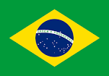
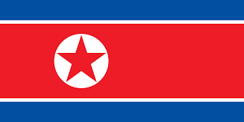
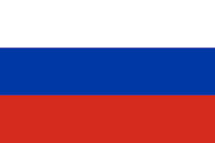
Country Backgrounds
http://unausa.nclud.com/attachments/27/Zombie_Pandemic_Lesson_Plan-_Country_Backgrounds.pdf

