Slide 1
Welcome to JWAC!
September 6, 2017

Slide 2
CNN
http://www.cnn.com/videos/cnn10/2017/09/05/ten-0906.cnn

Slide 3
Stay Informed!
Snapchat: ahsjwac
Twitter: @allenhsjwac
Website: www.allenhsjwac.weebly.com
Remind101: Text @allenjwac to 81010

Slide 4
Meetings
Time: Wednesdays 3:45-4:30pm
Room: F242 or A106
Sponsor: Mrs. Perry

Slide 5
Weekly News Quiz

Slide 6
Weekly News Quiz
President Trump on Tuesday ordered an end to the Obama-era executive action known as ….
Deferred Action for Childhood Arrivals
The Patriot Act
National Export Initiative
Ensuring Lawful Interrogations

Slide 7
Weekly News Quiz
2. Category 5 Hurricane …. has become one of the strongest storms recorded in the Atlantic, and is threatening to slam into Caribbean islands and Florida with catastrophic force later this week
Harvey
Irma
Katrina
Hato

Slide 8
Weekly News Quiz
3. North Korea has threatened to send more …. to the United States, days after testing the biggest nuclear weapon it has ever detonated.
Gift Packages
Chocolate
Nuclear Bombs
Donald Trump

Slide 9
Weekly News Quiz
4. “The …. government should end its efforts to weaken United Nations mechanisms that promote human rights”, said the Human Rights Watch yesterday.
Kenyan
Chinese
Syrian
North Korean

Slide 10
Weekly News Quiz
5. …. Was unable to play in the US open this year due to her maternity leave for her first baby.
Maria Sharapova
Madison Keys
Venus Williams
Serena Williams

Slide 11
Weekly News Quiz
6. …. Will cut 4000 jobs due to earnings showed its revenue and profit both fell in the first half of last year.
Netflix
Lego
Snapchat
Facebook

Slide 12
Weekly News Quiz
7. latest research shows the virus can selectively infect and kill hard-to-treat cancerous cells in adult brains.
Influenza
Chicken Pox
Ebola
Zika

Slide 13
Weekly News Quiz
8. Kate Middleton, the ….., is expecting her 3rd child
Duchess of Cambridge
Queen of England
Princess of England
Duchess of Cornwall

Slide 14
Weekly News Quiz
9. The death toll of hurricane harvey has reached at least ...
60
20
30
100

Slide 15
Weekly News Quiz
10. The supreme court of … declared the August 8th elections invalid, taking a giant step in the direction of fairer elections for the future of the country.
Cambodia
Egypt
Kenya
Pakistan

Slide 16
Weekly News Quiz Answers
A
B
A
B
D
B
D
A
A
C

Slide 17
Weekly News Quiz
President Trump on Tuesday ordered an end to the Obama-era executive action known as ….
Deferred Action for Childhood Arrivals
The Patriot Act
National Export Initiative
Ensuring Lawful Interrogations

Slide 18
Weekly News Quiz
2. Category 5 Hurricane …. has become one of the strongest storms recorded in the Atlantic, and is threatening to slam into Caribbean islands and Florida with catastrophic force later this week
Harvey
Irma
Katrina
Hato

Slide 19
Weekly News Quiz
3. North Korea has threatened to send more …. to the United States, days after testing the biggest nuclear weapon it has ever detonated.
Gift Packages
Chocolate
Nuclear Bombs
Donald Trump

Slide 20
Weekly News Quiz
4. “The …. government should end its efforts to weaken United Nations mechanisms that promote human rights”, said the Human Rights Watch yesterday.
Kenyan
Chinese
Syrian
North Korean

Slide 21
Weekly News Quiz
5. …. Was unable to play in the US open this year due to her maternity leave for her first baby.
Maria Sharapova
Madison Keys
Venus Williams
Serena Williams

Slide 22
Weekly News Quiz
6. …. Will cut 4000 jobs due to earnings showed its revenue and profit both fell in the first half of last year.
Netflix
Lego
Snapchat
Facebook

Slide 23
Weekly News Quiz
7. latest research shows the virus can selectively infect and kill hard-to-treat cancerous cells in adult brains.
Influenza
Chicken Pox
Ebola
Zika

Slide 24
Weekly News Quiz
8. Kate Middleton, the ….., is expecting her 3rd child
Duchess of Cambridge
Queen of England
Princess of England
Duchess of Cornwall

Slide 25
Weekly News Quiz
9. The death toll of hurricane harvey has reached at least ...
60
20
30
100

Slide 26
Weekly News Quiz
10. The supreme court of … declared the August 8th elections invalid, taking a giant step in the direction of fairer elections for the future of the country.
Cambodia
Egypt
Kenya
Pakistan

Slide 27
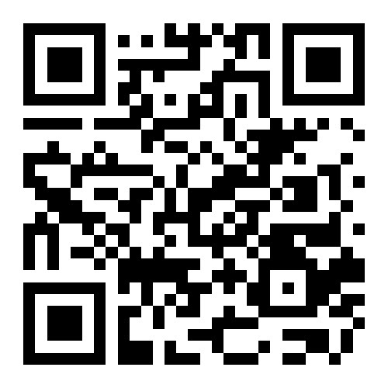
Interest Forms
Scan to fill out interest form on the JWAC website!
http://allenhsjwac.weebly.com

Slide 28
WorldQuest
World Quest Topics for 2017-2018 will be released in November!!

Slide 29
World Quest Practice Quiz
We know that nobody has studied for worldquest yet, but this kahoot will help familiarize you with the type of content that will be on AWQ and how it will work
Feel free to work with friends or use google :)
https://create.kahoot.it/#quiz/8df1719e-5bb3-4cab-ad25-dd522abd4feb

