Slide 1
Welcome to JWAC!
October 18, 2017

Slide 2
Weekly News Discussion: Rohingya

Slide 3
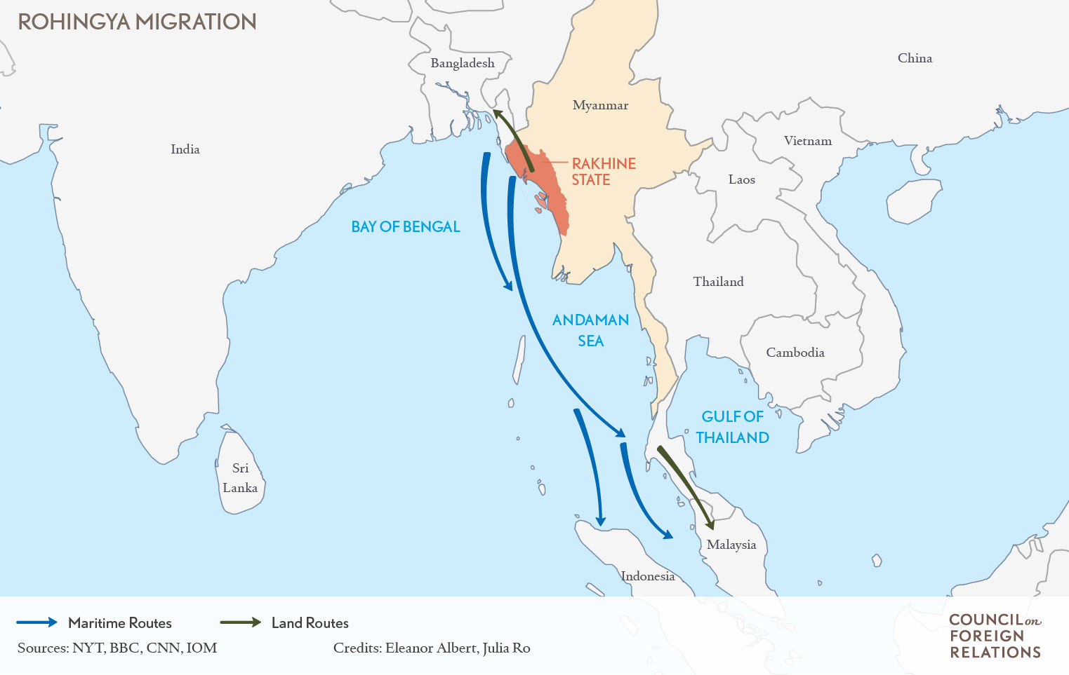
Rohingya Discussion

Slide 4
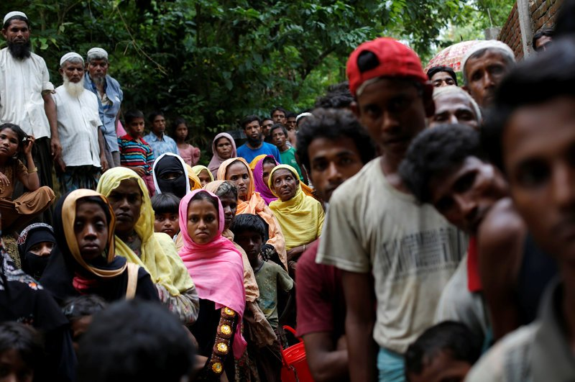
Rohingya Discussion

Slide 5
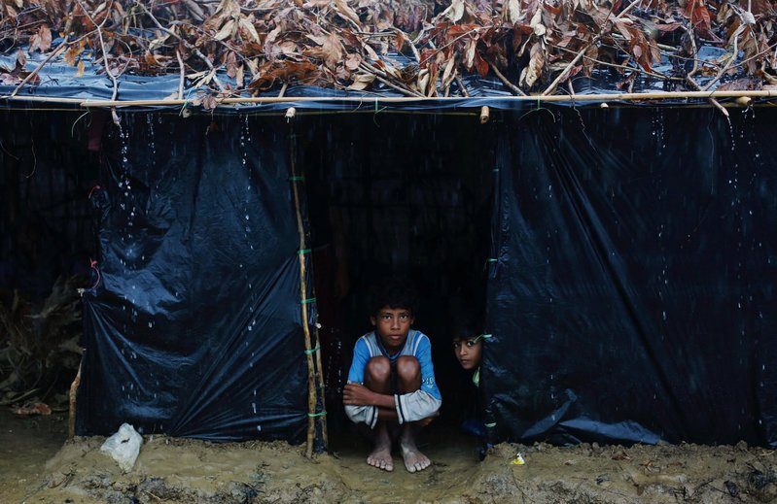
Rohingya Discussion

Slide 6
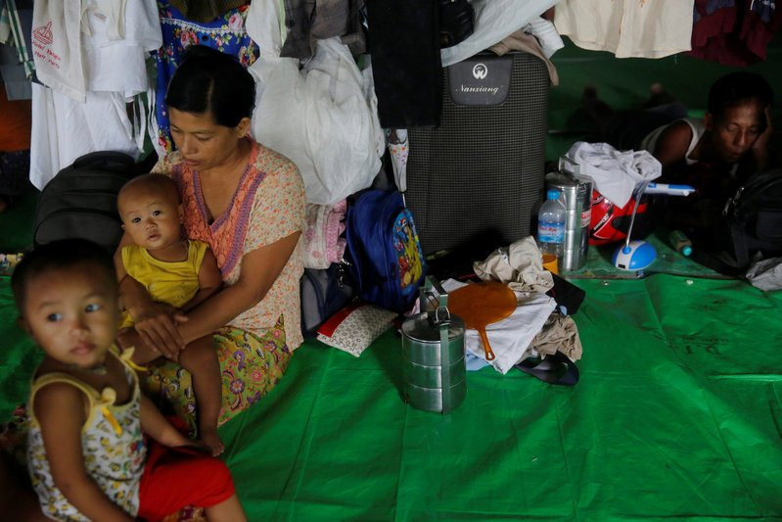
Rohingya Discussion

Slide 7
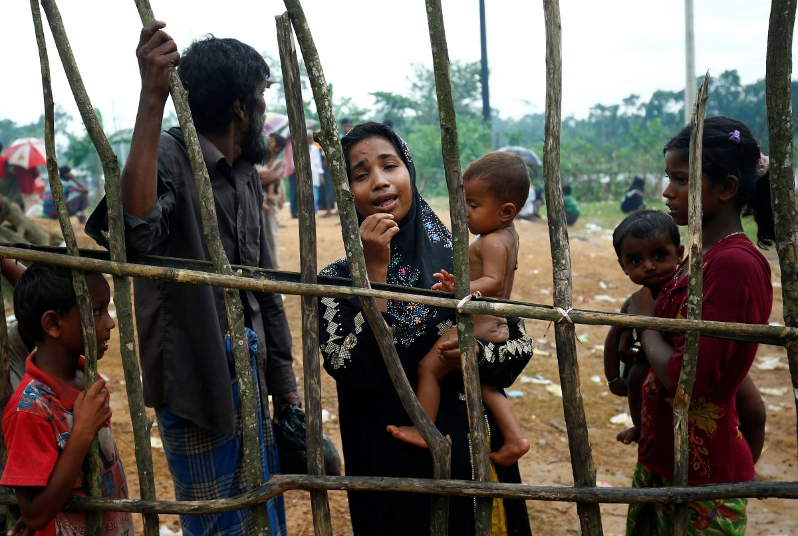
Rohingya Discussion

Slide 8
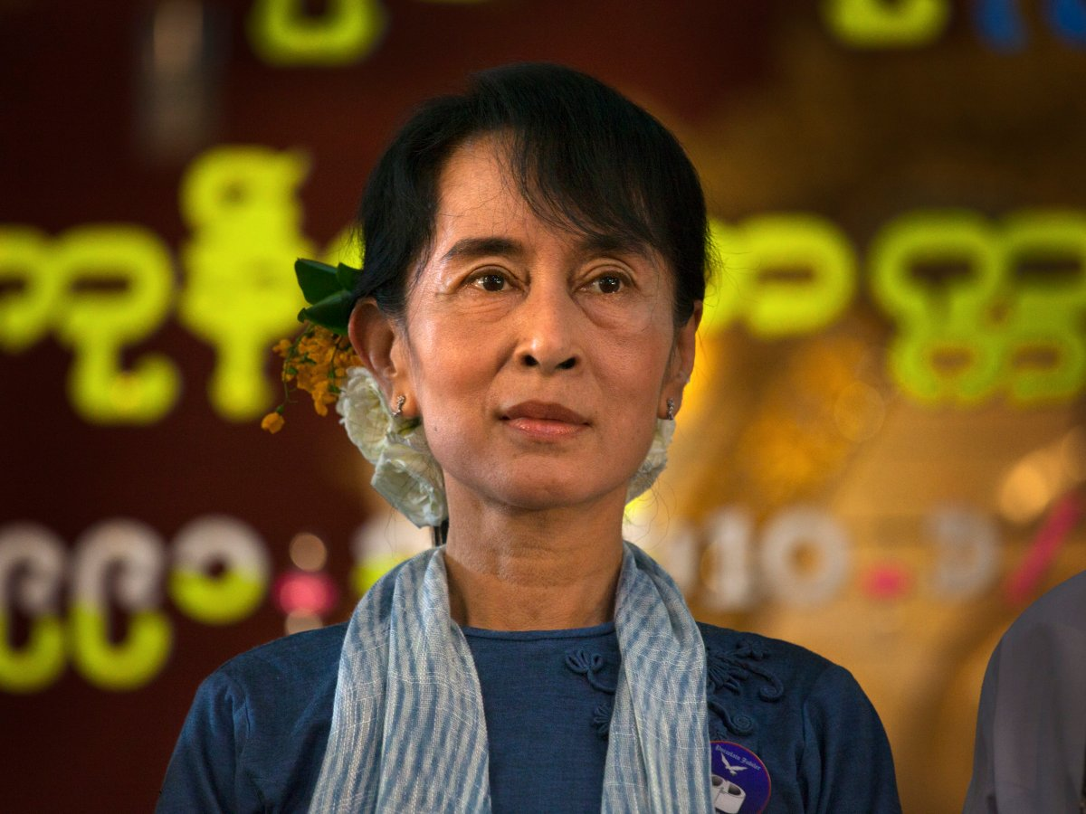
Rohingya Discussion

Slide 9
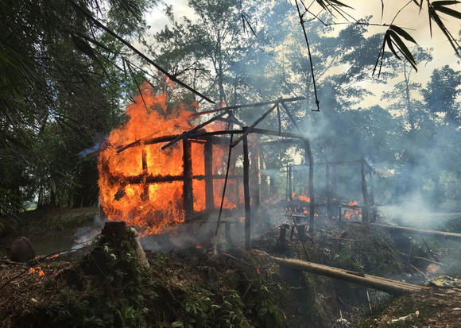
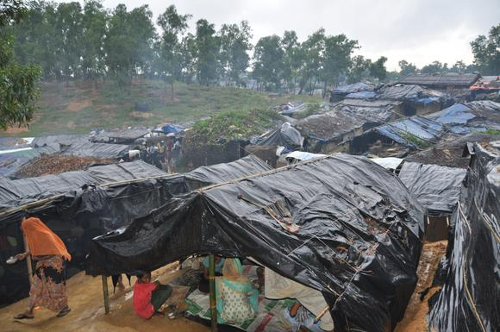
Weekly News Discussion: Rohingya
On August 25th, a Rohingya militant group (ARSA) attacked Myanmar security outposts
In Myanmar’s Rakhine State, the persecution of the Rohingya Muslim minority since August has led to a humanitarian and refugee crisis
Over 500,000 refugees (mostly children) have fled to Bangladesh
At least 176/471 villages destroyed
“A textbook example of ethnic cleansing," - Zeid Ra'ad Al Hussein (United Nations high commissioner for human rights)

Slide 10
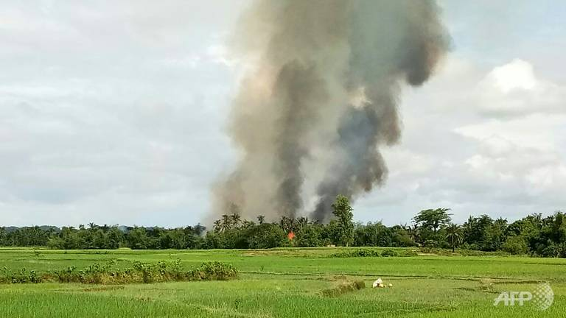
Rohingya and Jihad
With over half a million persecuted Rohingya Muslims, Al-Qaeda has called for Muslims to take arms and defend them
“Al-Qaeda has been trying to capitalise on the issue and called on its supporters to open a new front to help the Muslims in Myanmar in whatever way they can.” - Ludovico Carlino, IHS Markit's senior analyst
However, ARSA has disavowed links with international terrorist groups
“We do not welcome the involvement of these groups in the Arakan conflict.”
The Rakhine State is expected to be a flashpoint for terror groups
Border with Bangladesh
Jungles as safe havens
Corruption in Myanmar’s government

Slide 11
Sources
"Rohingya Crisis Raises Risks of Terrorism and Social Unrest" Yuji Kuronuma -- Nikkei Asian Review, October 3, 2017
"Global Terror Groups Set to Exploit Violence in Myanmar's Rakhine" Amy Chew -- Channel NewsAsia, October 3, 2017
"The Nobel Peace Prize Isn't About Peace" Richard Evans -- Foreign Policy, October 2, 2017
"Rohingya Children Witness Crimes Against Humanity" Peter Bouckaert -- Human Rights Watch, September 29, 2017

Slide 12
Discussion Questions
What are other countries’ stances on this issue?
What actions can UN, humanitarian organizations, etc. do to help displaced Rohingyas?

Slide 13
Meeting dates
Oct 25 Nov 01 Nov 08 Nov 15 ************NOT Nov 22 due to Thanksgiving Nov 29 Dec 06 Dec 13 ************NOT Dec 20 due to Exams

Slide 14
PLEASE SIGN UP FOR THE REMIND
Text @allenjwac to 81010

Slide 15
Dues!
$20
Due: 10/18
Must be paid at a JWAC Meeting
Cash or Check (If Check, make Checks payable to “AHS JWAC” and include Driver’s License number and phone number)

Slide 16
Model UN

Slide 17
Update!
We are currently looking for a co-sponsor to go to MUN conferences
AHS will not allow us to participate without a sponsor present
MUN activities and simulations

Slide 18
WorldQuest

Slide 19
WorldQuest
Local competition
February 15, 2018
10 topics
Countries, politics, global issues
(12 members)

Slide 20
WorldQuest
2017-18
NAFTA
ASEAN at 50
India’s Bid for Global Leadership
Combatting Climate Change
Cybersecurity
Saudi Arabia
Great Decisions
The Peacebuilding Toolkit
America’s Diplomats
Current Events

Slide 21
WorldQuest Topic Quiz (#2)
Split into groups of 4
Open WorldQuest Study Guide link via Remind

Slide 22
WorldQuest Simulation #2
You have 20 minutes!
Scan these topics: (WorldQuest Study guide link will be sent via Remind)
ASEAN at 50
Combating Global Climate Change
Saudi Arabia
America’s Diplomats
8 Question Quiz (2 questions per topic) - Work together!

Slide 23
WorldQuest Simulation Quiz 1

Slide 24
WorldQuest Simulation Quiz 2 - ASEAN at 50
In 2015, ASEAN’s combined GDP stood at US$___ trillion, positioning it as the 6th largest globally and 3rd in Asia.
2.4
10.6
5.8
6.7

Slide 25
WorldQuest Simulation Quiz 2 - ASEAN at 50
2. Several new initiatives have been established to strengthen the Southeast Asian capacity to address the emerging threat of health pandemics. ASEAN has put in place measures to boost its resiliency through the establishment of the ___ for Food Safety.
ASEAN Initiative for Immunization (AII)
ASEAN Resiliency Booster (ARB)
ASEAN Risk Assessment Centre (ARAC)
ASEAN Guidelines for Corporate Social Responsibility (CSR)

Slide 26
WorldQuest Simulation Quiz 2 - Global Climate Change
3. The U.S. now has __ coal-burning power plants that avoid dumping carbon dioxide into the air.
1500
250
37
2

Slide 27
WorldQuest Simulation Quiz 2 - Global Climate Change
4. The U.S. Energy Department’s budget for R&D is about $___ billion, approximately the same as it was five years ago.
5
15
76
10

Slide 28
WorldQuest Simulation Quiz 2 - Saudi Arabia
5. Saudi Arabia's interior ministry says it has executed ___ "terrorists", including Shia religious leader Nimr al-Nimr and a convicted al-Qaeda leader Faris al-Zahrani.
53
258
67
47

Slide 29
WorldQuest Simulation Quiz 2 - Saudi Arabia
6. The minimum age to fight in the military of Saudi Arabia is ___
18
17
21
16

Slide 30
WorldQuest Simulation Quiz 2 - America’s Diplomats
7. The US Under Secretary for Political Affairs is ___
Thomas A. Shannon, Jr.
Rex Tillerson
Nikki Haley
Carl Azuz

Slide 31
WorldQuest Simulation Quiz 2 - America’s Diplomats
8. The key pillars of American Diplomacy are ___
Aid, Democracy, Development, War Prevention
Negotiation, Peace, Development, Charity
Nationalism, Prosperity, War Prevention, Isolation
Peace, Prosperity, Democracy, and Economic development

Slide 32
WorldQuest Simulation Quiz 1 Answers

Slide 33
WorldQuest Simulation Quiz 2 - ASEAN at 50
In 2015, ASEAN’s combined GDP stood at US$___ trillion, positioning it as the 6th largest globally and 3rd in Asia.
2.4
10.6
5.8
6.7

Slide 34
WorldQuest Simulation Quiz 2 - ASEAN at 50
2. Several new initiatives have been established to strengthen the Southeast Asian capacity to address the emerging threat of health pandemics. ASEAN has put in place measures to boost its resiliency through the establishment of the ___ for Food Safety.
ASEAN Initiative for Immunization (AII)
ASEAN Resiliency Booster (ARB)
ASEAN Risk Assessment Centre (ARAC)
ASEAN Guidelines for Corporate Social Responsibility (CSR)

Slide 35
WorldQuest Simulation Quiz 2- Global Climate Change
3. The U.S. now has __ coal-burning power plants that avoid dumping carbon dioxide into the air.
1500
250
37
2

Slide 36
WorldQuest Simulation Quiz 2 - Global Climate Change
4. The U.S. Energy Department’s budget for R&D is about $___ billion, approximately the same as it was five years ago.
5
15
76
10

Slide 37
WorldQuest Simulation Quiz 2 - Saudi Arabia
5. Saudi Arabia's interior ministry says it has executed ___ "terrorists", including Shia religious leader Nimr al-Nimr and a convicted al-Qaeda leader Faris al-Zahrani.
53
258
67
47

Slide 38
WorldQuest Simulation Quiz 2 - Saudi Arabia
6. The minimum age to fight in the military of Saudi Arabia is ___
18
17
21
16

Slide 39
WorldQuest Simulation Quiz 2 - America’s Diplomats
7. The US Under Secretary for Political Affairs is ___
Thomas A. Shannon, Jr.
Rex Tillerson
Nikki Haley
Carl Azuz

Slide 40
WorldQuest Simulation Quiz 2 - America’s Diplomats
8. The key pillars of American Diplomacy are ___
Aid, Democracy, Development, War Prevention
Negotiation, Peace, Development, Charity
Nationalism, Prosperity, War Prevention, Isolation
Peace, Prosperity, Democracy, and Economic development

