Slide 1
PwC Academic WorldQuest
Teacher Preparation Workshop
Saturday, December 9, 2017

Slide 2
PwC Academic WorldQuest
AWQ Video: http://bit.ly/2koKEX8

Slide 3
PwC Academic WorldQuest
Kahoot! Quiz: https://play.kahoot.it/#/?quizId=276ad034-d83a-409a-8570-9013266447bb

Slide 4
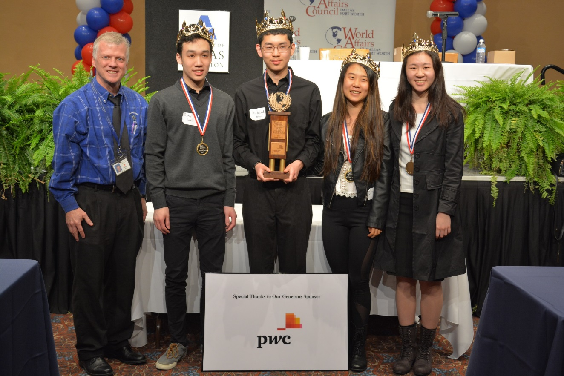
Local Academic WorldQuest
Thursday, February 15, 2018
8:00 AM- 1:30 PM
University of Texas at Arlington

Slide 5
Rules of the Game
Teams of 4 students
Roughly 100 teams play
10 rounds of 10 multiple choice questions
45 seconds to answer on scantron
10 minute break after rounds 3 and 7
Lunch after round 10
See scores and standings after each break

Slide 6
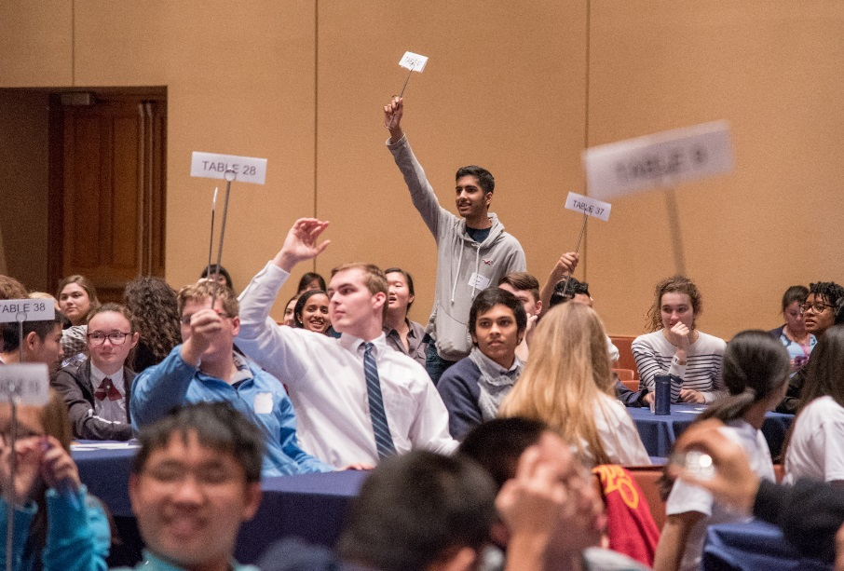
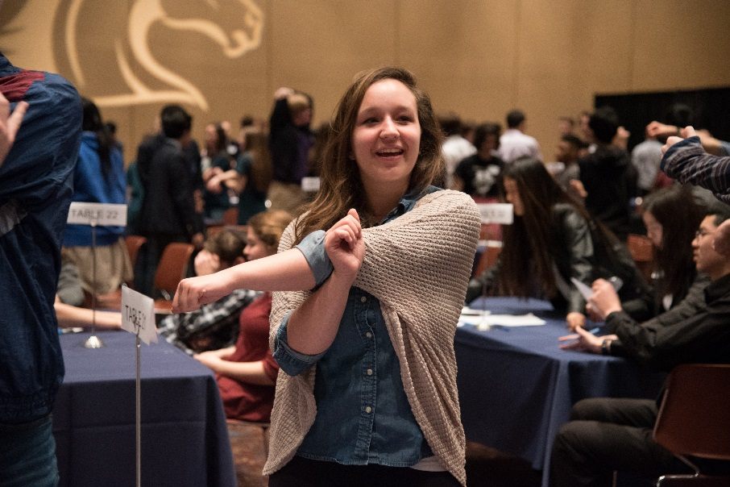
Rules of the Game
Stretching and “fun fact” between each round
4 students per team, no alternates
1 correct answer= 1 point
No answer/wrong answer= 0 points
Most correct answers out of 100 wins
If tie in 1st-3rd places, tie-breaker round
If still tie, then sudden death round

Slide 7
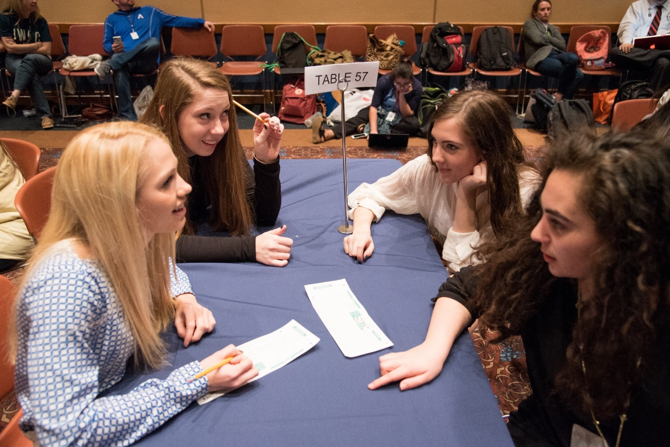
Rules of the Game
Teachers and guests stay “off the floor”
No consulting audience, phones, other teams, written materials
Penalty: forfeit round and forfeit 20 points
Team can call out cheating but if no evidence found, 2 point deduction for accusers
Bathroom only during breaks

Slide 8
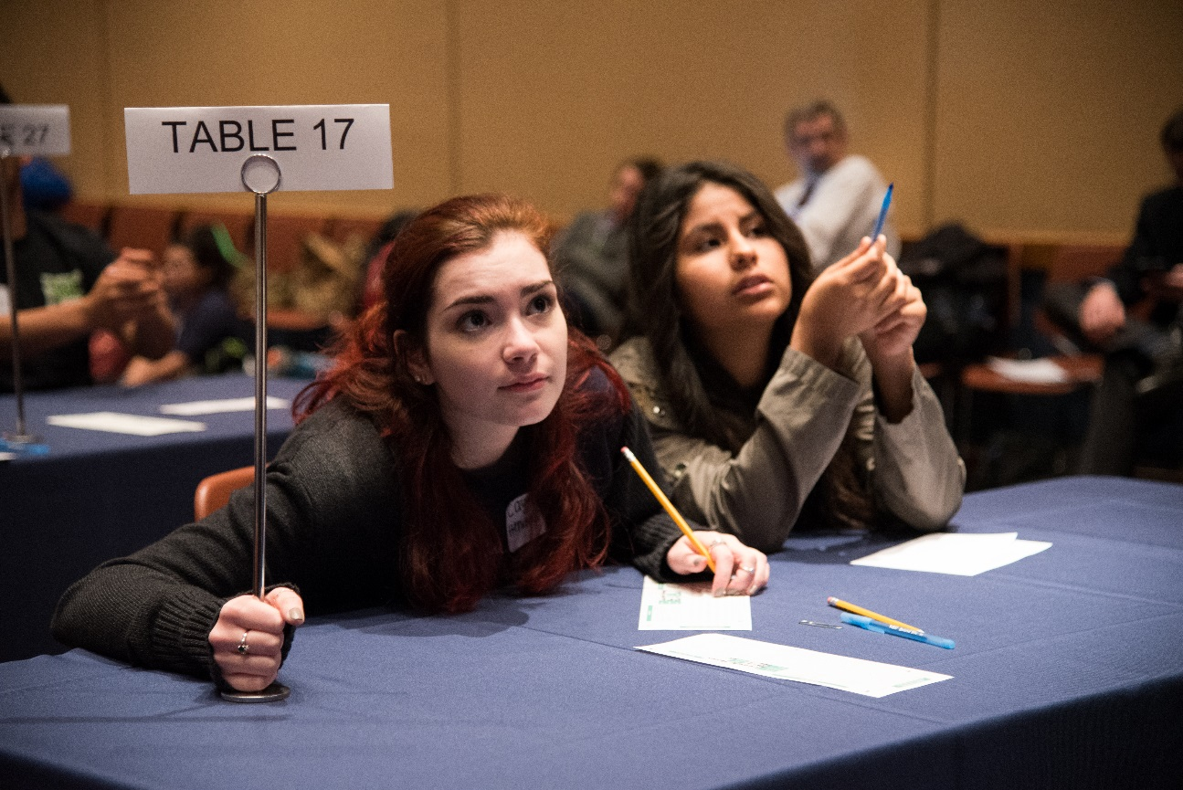
Rules of the Game
Challenging a question:
1 player may bring challenge form to judges during break
Cannot discuss challenges with audience members
Judge’s decision final
Successful challenges, all teams with new correct answer get 1 point
Unsuccessful challenges forfeit 1 point

Slide 9
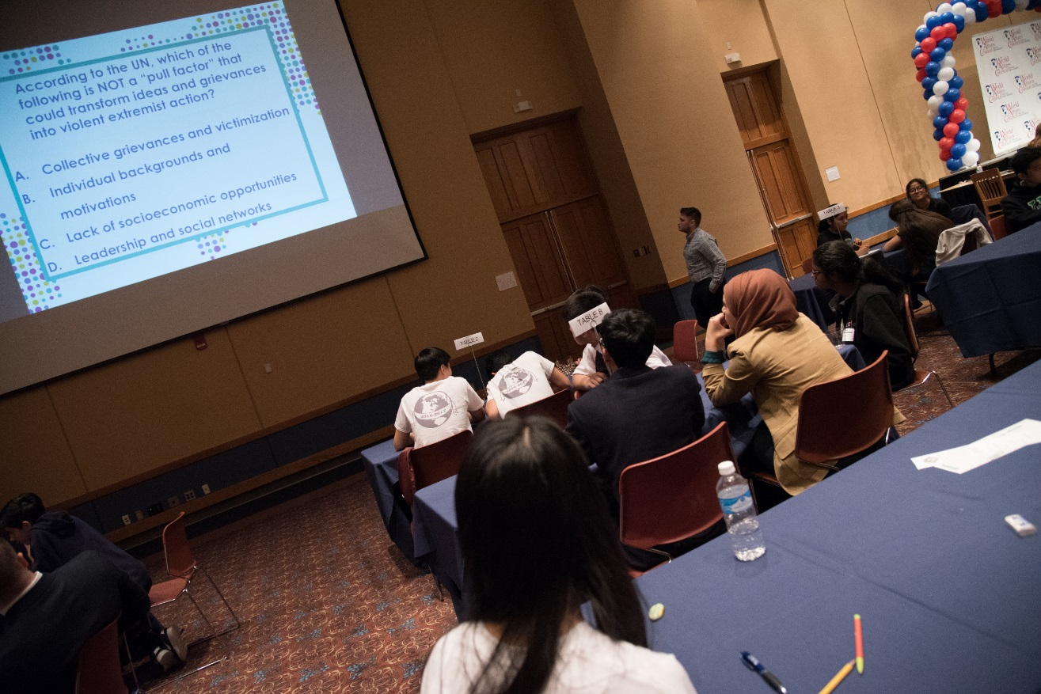
AWQ Study Guide
Study guide on website
Questions ONLY from these sources and articles (except Great Decisions and current events)
ENTIRE 2017 Great Decisions book fair game for local and national competitions
Current events from August 2017- day of competition
Weekly World News Update

Slide 10
2018 Topics
NAFTA
ASEAN at 50
India’s Bid for Global Leadership
Combatting Climate Change
Cybersecurity
Saudi Arabia
The Peacebuilding Toolkit
America’s Diplomats
Great Decisions
Current Events

Slide 11
NAFTA
This topic will discuss the positive and negative aspects of NAFTA, its origins, and whether or not it was a fair agreement to begin with.
Concentrations:
Economic impact
Trade
Manufacturing and production
Employment and wages

Slide 12
ASEAN at 50
This topic will be about the bloc’s goals, its charter, and its geopolitical ramifications.
Concentrations:
Past treaties
Aims and purposes
Influence
Countries/governments involved
Structure
China’s agenda
Historical implications

Slide 13
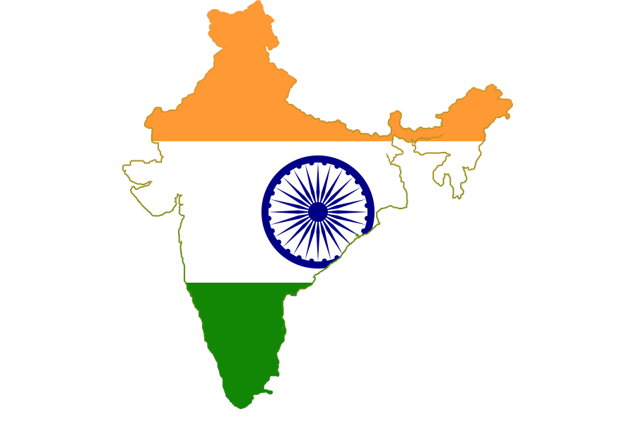
India’s Bid for Global Power
This topic addresses mostly domestic economic issues as well as its geography and relationships with neighboring states.
Concentrations:
Prime Minister’s influence
Foreign policy/international agreements
Successes/failures
Leadership potential
Geopolitical influence
Growth and GDP

Slide 14
Combatting Climate Change
This topic addresses the global response to combatting climate change in the public and private sectors.
Concentrations:
Green technology and innovation
Capabilities in renewable energy power
Terminology
Green manufacturing
Public policy efforts

Slide 15
Cybersecurity
This topic will cover cyber threats, hacks, and the influence of internet usage around the world.
Concentrations:
Dept. of Homeland Security bureaucracy
Dept. of Defense goals and strategies
Terminology
Cyber threats/warfare
International law
Russia’s influence
Viruses and implications

Slide 16
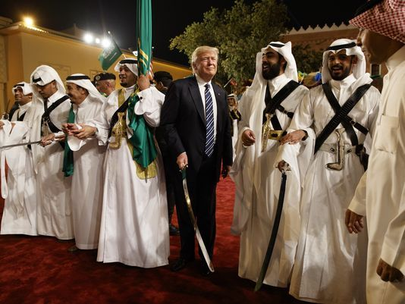
Saudi Arabia
This questions will center on the factors explaining the reasoning behind Saudi Arabia’s rise as a competitive player in world politics and the direction which it is heading.
Concentrations:
History and facts
Government and leaders
Military
Relationship with U.S.
Oil companies(Aramco)
Economy
Law and order and human rights

Slide 17
The Peacebuilding Toolkit
This Peacebuilding Toolkit covers core skills and concepts in the field of conflict resolution, as well as real-life stories and how individuals, communities and countries have used these skills to manage differences without violence and make peace possible.
Concentrations:
Reconciliation and justice
Facilitating dialogue
Coping mechanisms
Regional and global conflicts
Art and war
Levels of action

Slide 18
America’s Diplomats
This topic’s questions will highlight the structure and bureaucracy of the departments within the U.S. government which strive to promote American interests abroad. American diplomatic history as well as the related organizations in D.C. which share the State Department’s goals, will also be of interest.
Concentrations:
Pillars of American Diplomacy
History of State Dept.
Diversity efforts
American Foreign Service Association
U.S. Diplomacy Center
Consular functions

Slide 19
Great Decisions
These questions will be created from the annual program that focuses on critical international issues issued by the Foreign Policy Association, a member of the World Affairs Councils of America.
Concentrations:
The Future of Europe
Trade and Politics
Conflict in the South China Sea
Saudi Arabia in Transition
U.S. Foreign Policy and Petroleum
Latin America’s Political Pendulum
Prospects for Afghanistan and Pakistan
Nuclear Security

Slide 20
Current Events
This section will have an emphasis on the second half od 2017 as well as questions from WACA’s Weekly World News Update, which is a primary source that contains articles from a variety of media organizations worldwide. Current events questions, however, can come from everywhere.
Concentrations:
U.S. domestic and foreign policy
Regional conflicts
Significant legislation
International crises
World leaders and their actions
Issues related to this year’s competition topics

Slide 21
The Carlos and Malú 2018 Academic WorldQuest National Competition
Saturday, April 28, 2018
9:00 AM- 1:00 PM
Washington, DC
Venue TBD

Slide 22
Study Tips!

Slide 23
Study Tip #1
Start studying early!

Slide 24
Study Tip #2
Review the Academic WorldQuest guidelines and study materials.

Slide 25
Study Tip #3
Divide and conquer the material amongst teammates.

Slide 26
Study Tip #4
With multiple teams, group topic specialists together for study groups.

Slide 27
Study Tip #5
Have specialists on each subject give presentations on their own research.

Slide 28
Study Tip #5
Create your own multiple choice questions from the study guide resources.

Slide 29
Study Tip #6
Hold mock-competitions at your JWAC meetings.

Slide 30
Study Tip #7
Keep up-to-date on current events from around the world.

Slide 31
Study Tip #8
Include the latest edition of the Great Decisions publication in your study materials.

Slide 32
Study Tip #9
Practice answering multiple choice questions in 45 seconds.

Slide 33
Study Tip #10
Make preparing for the competition fun!

Slide 34
Practice Test!

