Slide 1
Welcome to JWAC!
Wednesday, September 26

Slide 2
Agenda
Announcements
Zombie Apocalypse
Debrief
NSLI-Y Presentation

Slide 3
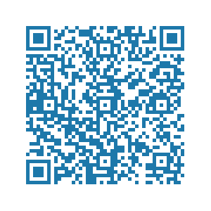
Contact
REMIND: @allenjwac
INSTAGRAM: @allenhsjwac
TWITTER: @allenhsjwac
WEEBLY: http://allenhsjwac.weebly.com/
SLACK QR:

Slide 4
Zombie Apocalypse!
Link to activity here.
Country Background link.

Slide 5
Zombie Apocalypse: Discussion Topics
International early warning systems;
Penalties for nations that fail to accurately report zombie threats;
Quarantine procedures and facilities as well as refugee centers;
The proper role of WHO in a zombie pandemic;
Financial and technical responsibilities of reporting and containing a pandemic (developed countries vs. lesser developed countries)

Slide 6
Debrief
Draft of resolutions
Join Slack!

Slide 7
Full scholarship funded by the Department of State to study abroad in a language immersion program!
Language classes! Host families! Cultural excursions!
Summer (6 weeks) or Year (9-10 months) programs
Scholarships available for:
Arabic
Chinese (Mandarin)
Hindi
Indonesian
Korean
Persian (Tajiki)
Russian
Turkish

Slide 8
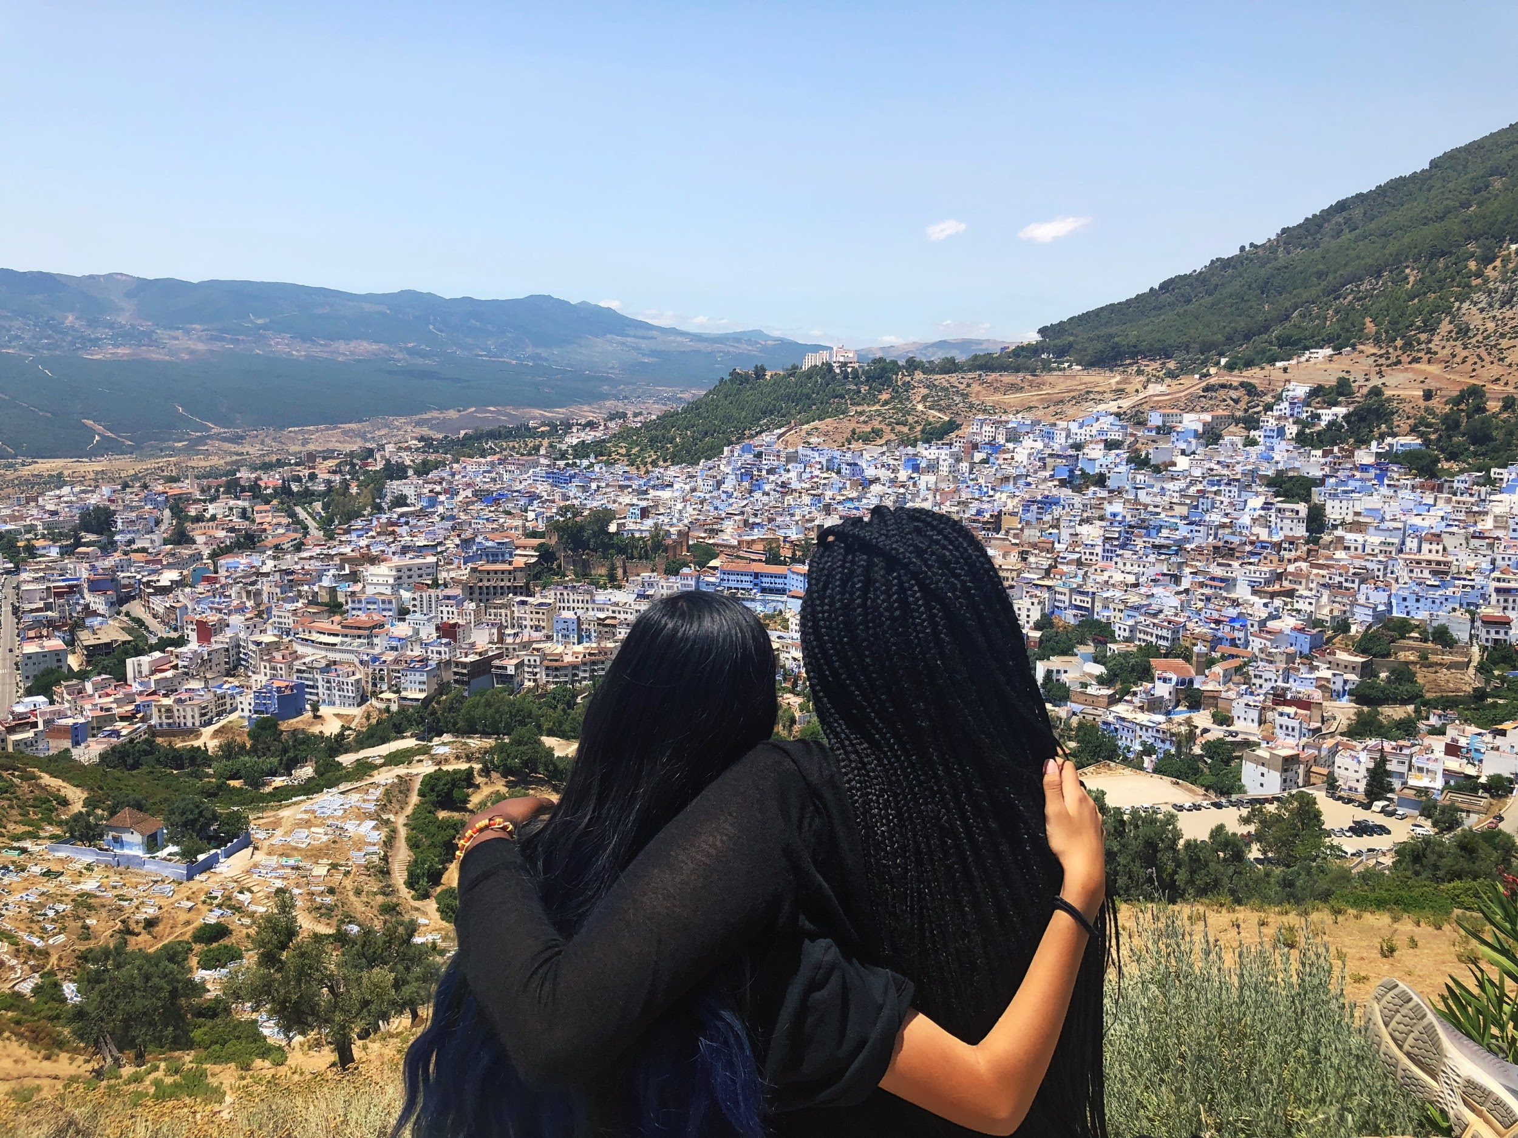
Noor’s Program: Rabat, Morocco (Summer 2018)
Chefchaouen, Morocco: “The Blue City”
The Sahara Desert

Slide 9
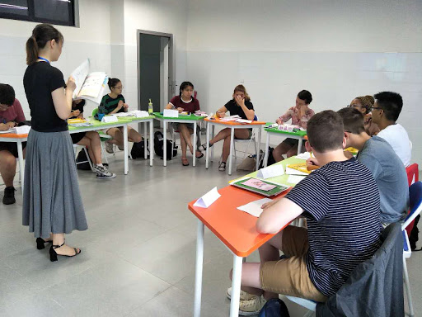
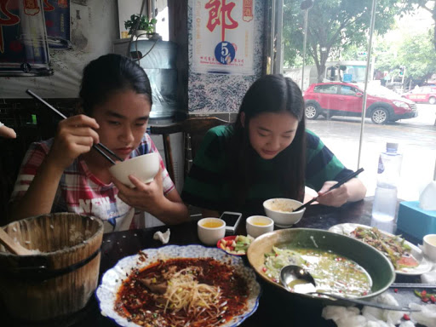
Leia’s Program: Chengdu, China (Summer 2017)

