Slide 1
WELCOME TO JWAC!
FIRST MEETING- September 19, 2018

Slide 2
The Board
Sponsor- Mr. Park
President- Johnson Lin
Vice President- Leia Sing
Secretary- Shaheer Rahman
Treasurer- Pranay Srivastava
Social Media Relations- Noor Khan

Slide 3
WHAT DO WE DO?

Slide 4
WorldQuest
Local to National Competition
In February
10 topics
Countries, politics, global issues
(12 members)

Slide 5
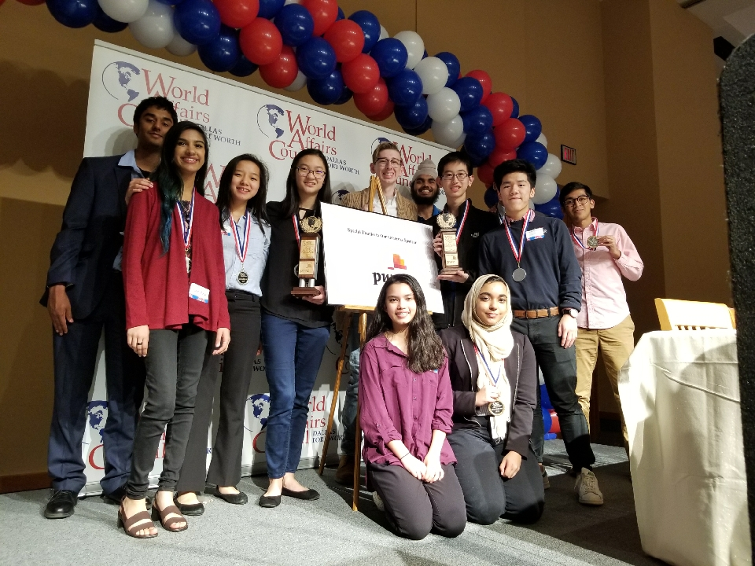
2017-18 WQ Competition placed 2nd, 3rd, and 9th out of 90+ teams in DFW area
We need to be 1st to advance to the national competition in D.C.
Winners 2 years ago won $10,000 and last year each person won a Surface Pro
We can beat Plano :)
3 AHS JWAC WQ TEAMS 2017-18

Slide 6
Model UN
UN General Assembly
Diplomacy, Negotiation, Decision-Making
Delegates
Policy
Conferences

Slide 7
General Meetings
1ST SEMESTER: EVERY WEDNESDAY*, 3:45-4:35PM
2ND SEMESTER: EVERY OTHER WEDNESDAY*, 3:45-4:35PM*
ROOM: G130, MR. PARK’S ROOM

Slide 8
Membership Dues + Fundraising
Membership Dues: TBD (based on the number of people that’ll join)
The more people that join, the cheaper the dues!
Most likely will be less than or equal to $15
Not due till October 10th
Fundraising:
Chocolate Bars through World’s Finest Chocolate

Slide 9
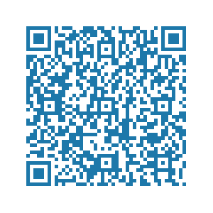
Contact Us and Get Updated
Remind- text @allenjwac to 81010
Twitter- @allenhsjwac
Instagram- @allenhsjwac
Slack- ahsjwac.slack.com <- to join: https://bit.ly/2xfniJC --------------->
PRIMARY IN-CLUB COMMUNICATION THROUGH REMIND AND SLACK

Slide 10
Zombie Apocalypse
Zambia, a country in Africa, has been infected with zombies that are unkillable except through nuclear destruction. The zombie disease is transferable to more humans and reversal back to a human is impossible.
Task: First, Introduce yourselves to your group. Second, Decide among yourselves what countries y’all want to represent. Third, Discuss and Debate possible solutions to this world crisis. As the Model UN, you must consider your state’s perspective and other state’s perspectives on this issue and reach a final resolution.

