Slide 1
JWAC Meeting
February 8, 2017

Slide 2
CNN 10 (r.i.p. Student News)
http://www.cnn.com/2017/02/07/studentnews/ten-content-weds/

Slide 3
Meeting information
Time: 3:45-4:30pm
Dates: Every Wednesday
Room: F242 or the cafeteria

Slide 4
Communications
Twitter: @allenhsjwac
Email: allenhsjwac@gmail.com
Website: http://allenhsjwac.weebly.com/
Remind:
Text @allenjwac to 81010
*Sign up to receive updates about meeting dates

Slide 5
Remind - DFW JWAC Members
Text @jwacgen to 81010

Slide 6
JWAC Registration
Register for JWAC by visiting the website (www.allenhsjwac.weebly.com) and clicking the “Join Now” button!

Slide 7
JWAC in February
Feb 8: Final WorldQuest mock test
Feb 8 (evening): Top 12 individuals announced through Remind + 1 alternate
Feb 15: WorldQuest cram session
Feb 22: WorldQuest cram session
Feb 23 (Thursday): WorldQuest
Mar 1: Regular JWAC meeting
Introducing Model UN
Group Activities

Slide 8
Weekly News Quiz!

Slide 9
Question 1
A federal judge in ..?.. ordered a nationwide hold on President Trump’s travel ban on refugees and people from seven countries.
Colorado
California
New York
Washington

Slide 10
Question 2
President Trump nominated justice ..?.. of the U.S. Court of Appeals for the Tenth Circuit for the open seat on the Supreme Court.
Merrick Garland
Neil Gorsuch
Thomas Hardimann
William Pryor

Slide 11
Question 3
French authorities opened a terror investigation after police shot a machete-wielding attacker outside of the ..?.. in Paris.
Louvre Museum
Eiffel Tower
Musee d’Orsay
Arc de Triomphe

Slide 12
Question 4
The Senate confirmed Rex Tillerson, former CEO of ..?.., as secretary of state.
ExxonMobil
Chevron
Halliburton
General Motors

Slide 13
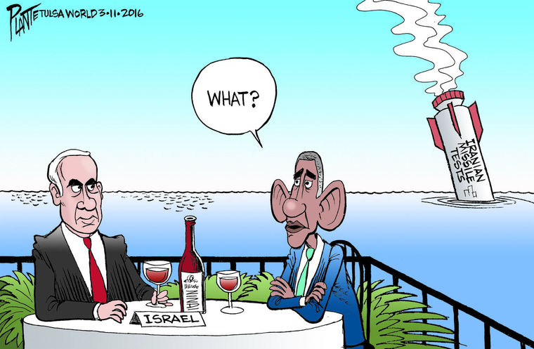
Question 5
The Trump administration issued new sanctions on ..?.. after the country test-fired medium range missiles.
Russia
Iran
North Korea
Pakistan

Slide 14
Question 6
After five days of massive protests, the government of ..?.. withdrew a decree that would have shielded government officials from “minor” corruption offenses.
Hungary
Bulgaria
Romania
Greece

Slide 15
Question 7
The classic British novel “..?..” became a surprise best-seller on Amazon.
Nineteen Eighty-Four
Animal Farm
Brave New World
The Stranger

Slide 16
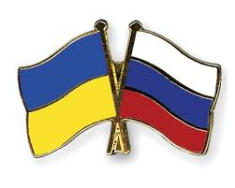
Question 8
The secretary general of NATO asked Russia to help end a recent surge in violence in eastern ..?.. between government forces and rebels.
Kazakhstan
Yemen
Syria
Ukraine

Slide 17
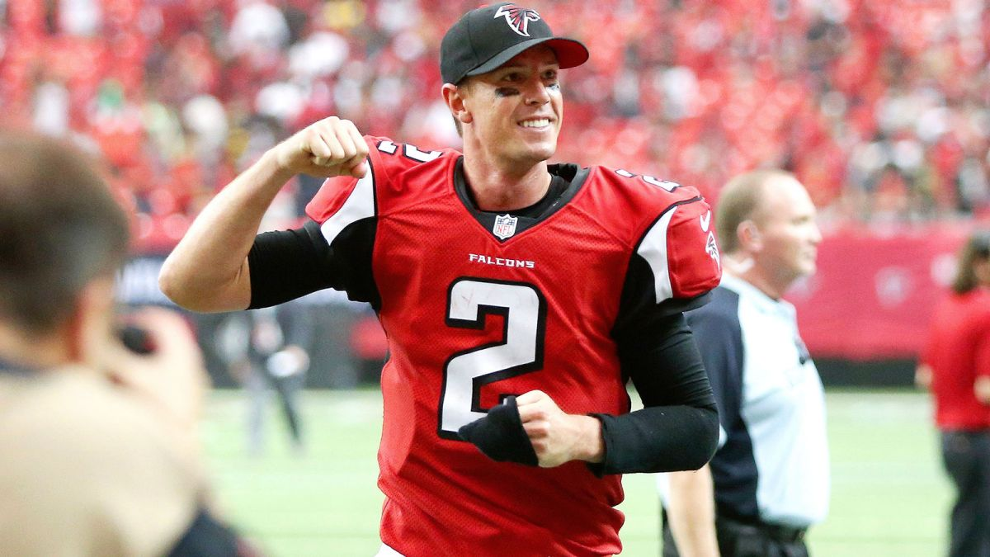
Question 9
Atlanta quarterback ..?.. won the NFL MVP award, but failed to beat New England in Super Bowl 51.
Dak Prescott
Matt Ryan
Aaron Rodgers
Tom Brady

Slide 18
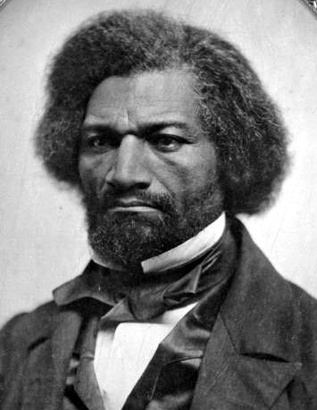
Question 10
Famous abolitionist leader ..?.., who died in 1895, was trending on Google after President Trump spoke of him at a Black History Month event and implied he was still alive.
Booker T. Washington
W.E. B. DuBois
Frederick Douglass
George Washington Carver

Slide 19
Answers
D
B
A
A
B
6) C
7) A
8) D
9) B
10) C

Slide 20
WorldQuest

Slide 21
What is WorldQuest?
2 WEEKS LEFT!
Thursday, February 23
8am-1:30pm
UT Arlington
10 topics, 100 multiple-choice
Around 100 teams around the area compete in the event

Slide 22
WorldQuest Topics
Current Events
Great Decisions
Peace and Conflict in Today’s World (USIP)
Combating Infectious Disease
European Union
Countering Violent Extremism
Turkey
Global Megacities
China
Women in Technology

Slide 23
Today’s Topic:
Final WorldQuest
Mock Test
Study Guide Link
http://www.dfwworld.org/file/education/AWQ2017StudyGuide.pdf
*Study your best 2 topics

Slide 24
Next week’s topic:
WorldQuest cram session

Slide 25
Meeting adjourned
See you next week!
Keep studying :)

