Slide 1
Welcome to JWAC!
Wednesday, 3/6

Slide 2
Agenda
Announcements
MUN INFO
Elections Info

Slide 3
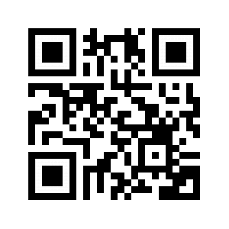
Contact
REMIND: @allenjwac
INSTAGRAM: @allenhsjwac
TWITTER: @allenhsjwac
WEEBLY: http://allenhsjwac.weebly.com/
SLACK WEB: ahsjwac.slack.com
-to join: bit.ly/2pwQpnm
-scan to join:

Slide 4
Announcements
MUN State Conference 4/12-4/14
$260 DUE today
Elections On 4/17

Slide 5
MODEL UN

Slide 6
Elections
Sign-ups for positions will be open soon
No Google Slides or PowerPoint of any sort
3 minute speech allowed
All board positions are open to run against
May run as Co-presidents
If after elections there are only rising seniors, there will be the possibility of an additional board position limited to only rising juniors or sophomores
If you do not succeed in running for your initial position, you may run for another position, but only limited to a 20 second reiteration
The meeting will take extra long (likely till 5PM)
For additional updates, follow the remind

Slide 7
MEETING ADJOURNED

