Slide 1
JWAC Meeting
February 15, 2017

Slide 2
CNN 10 (r.i.p. Student News)
http://www.cnn.com/specials/student-news-transcripts

Slide 3
Meeting information
Time: 3:45-4:30pm
Dates: Every Wednesday
Room: F242

Slide 4
Communications
Twitter: @allenhsjwac
Email: allenhsjwac@gmail.com
Website: http://allenhsjwac.weebly.com/
Remind:
Text @allenjwac to 81010
*Sign up to receive updates about meeting dates

Slide 5
Remind - DFW JWAC Members
Text @jwacgen to 81010

Slide 6
JWAC Registration
Register for JWAC by visiting the website (www.allenhsjwac.weebly.com) and clicking the “Join Now” button!

Slide 7
Weekly News Quiz!

Slide 8
Question 1
An appeals court in ..?.. upheld a suspension of President Trump’s executive order on immigration, which had banned travel from seven countries.
Sacramento
San Francisco
Seattle
San Bernardino

Slide 9
Question 2
Construction resumed on the Dakota Access pipeline, after the Trump administration granted an easement for the pipeline company to drill beneath the ..?.. River.
Mississippi
Colorado
Yellowstone
Missouri

Slide 10
Question 3
Betsy DeVos was sworn in as U.S. secretary of ..?.. after Vice President Mike Pence cast the tiebreaking vote in the Senate to confirm her.
Health and human services
Commerce
Labor
Education

Slide 11
Question 4
..?.. has withdrawn permission for the U.S. to carry out special operations ground missions after a recent raid killed civilians including an 8-year-old girl.
Yemen
Syria
Iraq
Afghanistan

Slide 12
Question 5
Jovenel Moise was confirmed as the new president of ..?.., 15 months after voting took place.
Somalia
Haiti
Sudan
Algeria

Slide 13
Answers
B
D
D
A
B

Slide 14
JWAC in February
Feb 15: WorldQuest cram session
Feb 17: Group study session at Caffe Promenade?
600 E Bethany Dr #100, Allen, TX 75002
Feb 22: WorldQuest cram session
Feb 23 (Thursday): WorldQuest
Mar 1: Regular JWAC meeting
Introducing Model UN
Group activities

Slide 15
Next Meeting
Photo Release Form and $7 registration fee
Study material
Google sample 2016/2017 World Quest questions
Study group session?

Slide 16
WorldQuest

Slide 17
What is WorldQuest?
Next week!
Thursday, February 23
8am-1:30pm
UT Arlington
10 topics, 100 MC
30 seconds per question
Around 100 teams

Slide 18
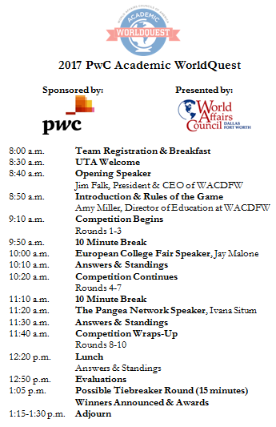
WorldQuest Information
When: February 23
Where: 6:45am main entrance
Dress: Business casual
Bring:
Pencil and paper (optional)
A smile :)

Slide 19
Sample Questions
San Diego WAC Sample Questions
http://sdwac.org/wp-content/uploads/2014/08/Round-8-10-Answers.ppt
Montana WAC Sample Questions
http://www.montanaworldaffairs.org/newsite/wp-content/uploads/2015/11/2016-Sample-AWQ-Competition-Questions-vf.pdf

Slide 20
WorldQuest Cram Session
Current Events
Great Decisions
Peace and Conflict in Today’s World (USIP)
Combating Infectious Disease
European Union
Countering Violent Extremism
Turkey
Global Megacities
China
Women in Technology
http://www.dfwworld.org/file/education/AWQ2017StudyGuide.pdf

Slide 21
Next week’s topic:
WorldQuest cram session

Slide 22
Meeting adjourned
See you next week!
Keep studying :)

