Slide 1
Welcome to JWAC!
Wednesday, October 17

Slide 2
Agenda
Announcements
Parliamentary Procedure
Qatar MUN Debate
YMCA MUN Forms

Slide 3
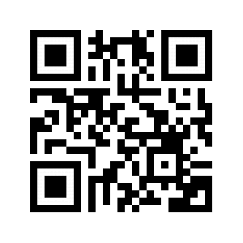
Contact
REMIND: @allenjwac
INSTAGRAM: @allenhsjwac
TWITTER: @allenhsjwac
WEEBLY: http://allenhsjwac.weebly.com/
SLACK WEB: ahsjwac.slack.com
-to join: bit.ly/2pwQpnm
-scan to join:

Slide 4
Dues
$10 Dues for all JWAC members
Dues are required for participation in WorldQuest
Due on 11/7 (3 meets from today)

Slide 5
WorldQuest
3 Teams of 4 from AHS to compete at regionals
Competition Date: February 12th
Use Study Guide Materials
TOPICS
1. Country in Focus: Qatar
2. How to Deal with North Korea
3. Global Refugee and Migration Crisis
4. #WeAreNATO – The Alliance at 70
5. Great Decisions (2018 Foreign Policy Association publication)
6. Japan-U.S. Relations
7. Space Policy
8. World Trade Organization (WTO)
9. Bridging Divides to Build Peace
10. Current Events (from August 2018 to day of the competition)

Slide 6
MODEL UN

Slide 7
Recap of Zombie Apocalypse
Direct speeches to the entire assembly, not specific delegates
Keep comments to yourself until given the opportunity to speak up
Vote and argue on resolutions based NOT on your personal opinions, but your country’s perspectives (you are representing a nation, not yourself)
Briefly study+understand your country’s political, economic, and social situation before the debate (a good source is the CIA Factbook)
Mention your country before speaking
Overall it was a great first debate; we are glad that many of y’all spoke up :)

Slide 8
Parliamentary Procedure
Point of Order: | This point may be raised when you feel that a delegate or the Chair is not abiding by correct parliamentary procedure (as laid out for the conference). A point of order is allowed to interrupt the speaker.
Point of Personal Privilege: | This point is used to indicate personal discomforts or impediments to debate. It may be raised during the debate if, for example, you cannot hear the speaker or feel uncomfortably hot or cold. This point is allowed to interrupt a speaker, but may not refer to the content of any speech or working paper.
Point of Inquiry: | This point may be raised after a speaker yields to questions. It is used to ask a question of the speaker relating to the speech just given. It may also be used to ask the chair a questions regarding parliamentary procedure during a normal session.

Slide 9
Parliamentary Procedure Continued
Motion to Open Debate: | This is the first motion of the conference and is made to move into formal debate and open the primary speakers list. If there are multiple topics on the agenda, the body will first debate on the order they are to be discussed until there is a motion to set the agenda. All delegates wishing to be added to the speakers list should raise their placards at the request of the chair or send a note to the dais. Speaking time during debate may be limited with a Motion to Limit Debate (see below).
Motion to Adjourn the Session: | This motion adjourns the committee sessions for good. It will only be entertained by the chair at the end of the last committee session. This motion requires a second, is not debatable, and needs a simple majority to pass.

Slide 10
Parliamentary Procedure Continued
Motion to Enter Unmoderated Caucus: | This motion temporarily suspends the meeting for a specified amount of time. Use it to create resolutions, talk to other delegates, or anything else you may need to do. It requires a second, is not debatable, and needs a simple majority to pass.
Motion to Enter Moderated Caucus: | This motion brings the body into a moderated debate on the issue on the floor for a specified amount of time. The moderating officer will then recognize speakers for a specified amount of time, who cannot yield to anyone but the Chair at the end of their speech. This motion requires a second, is not debatable, and needs a simple majority to pass. This motion may not be made once debate has been closed.

Slide 11
Country in Focus: Qatar | MUN Debate
TOPIC: Countering Terrorism (Qatar)
History: In the last 60 years, Qatar has transformed itself from a poor protectorate of Britain to an independent with rich resources of oil and natural gas
Country Info: 2.3M people, 99% of which live in urban settings; absolute monarchy; 3rd in natural gas reserves globally (13% of world total); exports to mainly Japan (17.3%), S Korea (16%), India (12.6%), China (11.2%); imports mainly from China (10.9%), US (8.9%), UAE (8.5%), Germany (8.1%); Primarily an Islamic nation; World Cup to be held in 2022
Situation: In 2017, due to accusations of Qatar supporting terrorism with ISIL, Saudi Arabia, United Arab Emirates, Bahrain, Egypt, and more nations have cut off diplomatic ties with Qatar, preventing Qatar from entering these nations through sea, land, or air; Qatar struck a deal with militant groups in Iraq+Syria, paying millions to release a few thousand captured Qataris; America has openly supported Saudi Arabia even though America’s largest air base of the Middle East is in Qatar; Qatar’s market dropped 7.3% on first day of diplomatic severance; These nations also demand the shut down Al-Jazeera, Qatar’s state sponsored media, terminate Turkish military presence in Qatar, payment of reparation for wrongs, announce severance of ties with terrorist groups, align itself with other Gulf Arab States economically, militarily, politically, and socially

Slide 12
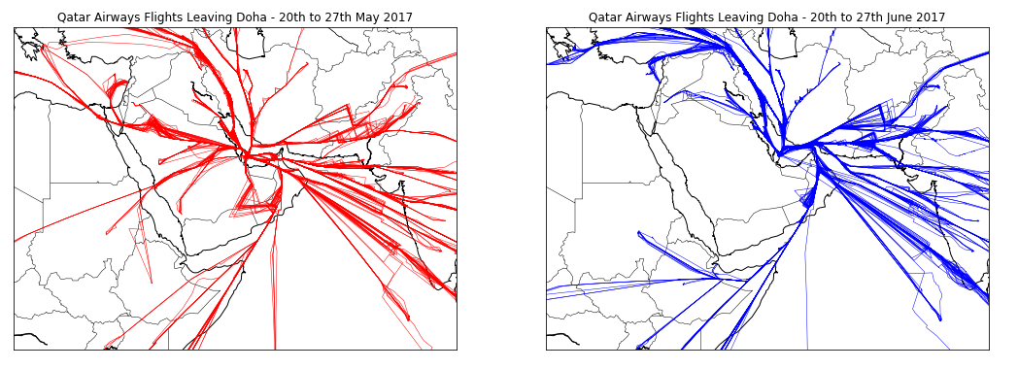
Country in Focus: Qatar | MUN Debate

Slide 13
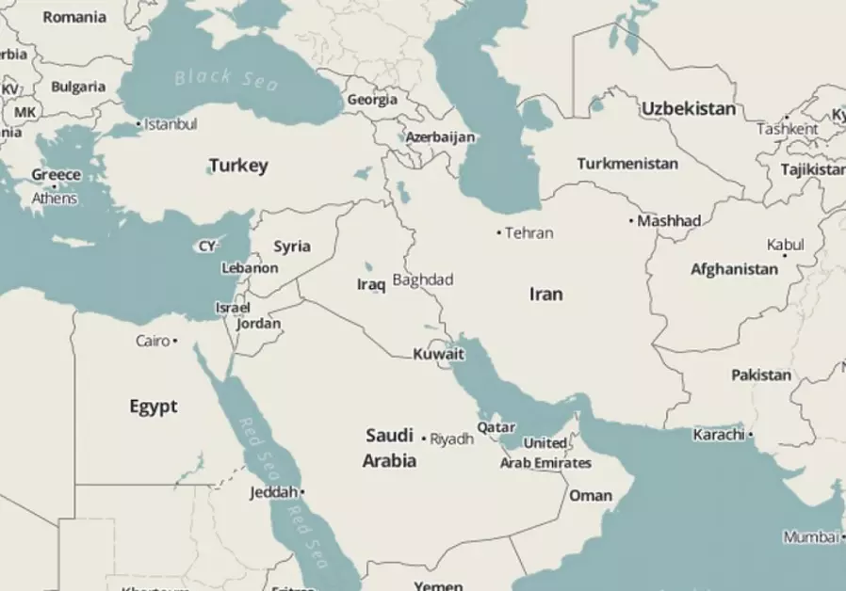
Country in Focus: Qatar | MUN Debate

Slide 14
YMCA MUN FORMS!
Please turn in $30 and registration forms if you have them!

Slide 15
MEETING ADJOURNED

