Slide 1
Welcome to JWAC!
Wednesday, October 10

Slide 2
Agenda
Announcements
Resolutions
Moderated Caucus
Debrief

Slide 3
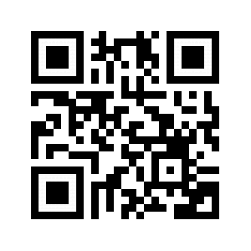
Contact
REMIND: @allenjwac
INSTAGRAM: @allenhsjwac
TWITTER: @allenhsjwac
WEEBLY: http://allenhsjwac.weebly.com/
SLACK WEB: ahsjwac.slack.com
-to join: bit.ly/2pwQpnm
-scan to join:

Slide 4
Dues
$10 Dues for all JWAC members
Dues are required for participation in WorldQuest
Due on 11/7 (2 meets from today)

Slide 5
YMCA Model UN
Please bring forms and dues ($30) next meet (10/17) to register for YMCA MUN
The YMCA MUN is independent of AHS JWAC but we still highly encourage y’all to register

Slide 6
Zombie Apocalypse!
Link to activity here.
Country Background link.

Slide 7
Zombie Apocalypse: Discussion Topics
International early warning systems;
Penalties for nations that fail to accurately report zombie threats;
Quarantine procedures and facilities as well as refugee centers;
The proper role of WHO in a zombie pandemic;
Financial and technical responsibilities of reporting and containing a pandemic (developed countries vs. lesser developed countries)

Slide 8
Zombie Apocalypse: Moderated Caucus
Moderated Caucus: Pro-Con Speeches
Prepare:
Review your committee’s resolutions.
Practice arguing for/defending your resolution.
Choose 2 representatives to present your block’s resolution
2 con and 2 pro speakers outside your block will each then speak for/against your resolution
The club members will then vote on whether or not to pass the solution
The block with the most yes votes will win a prize from Johnson :)

Slide 9
Debrief

